Slide 1
World Real Estate
Presented by: Asma Ameen

Slide 2
Content
Count of Apartments by Country
Price in USD by Country
Building Construction Year vs. Price in USD
Price in USD vs. Apartment Total Area

Slide 3
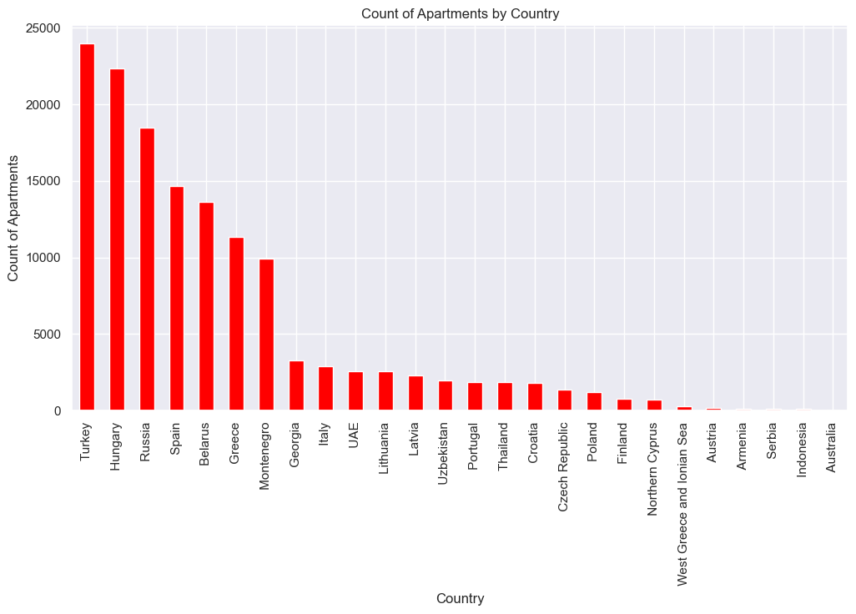

Slide 4
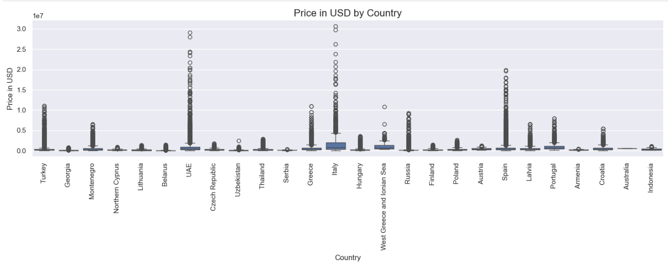

Slide 5
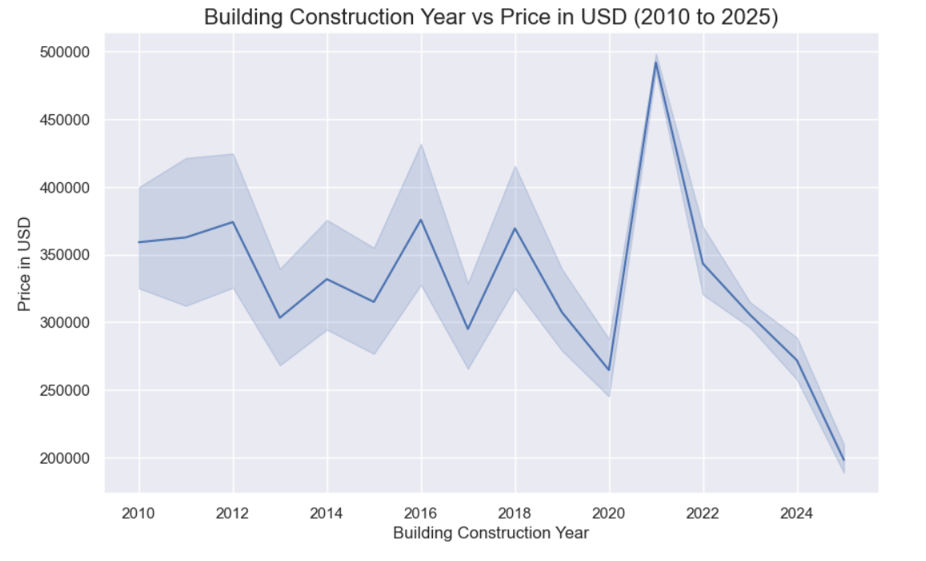

Slide 6
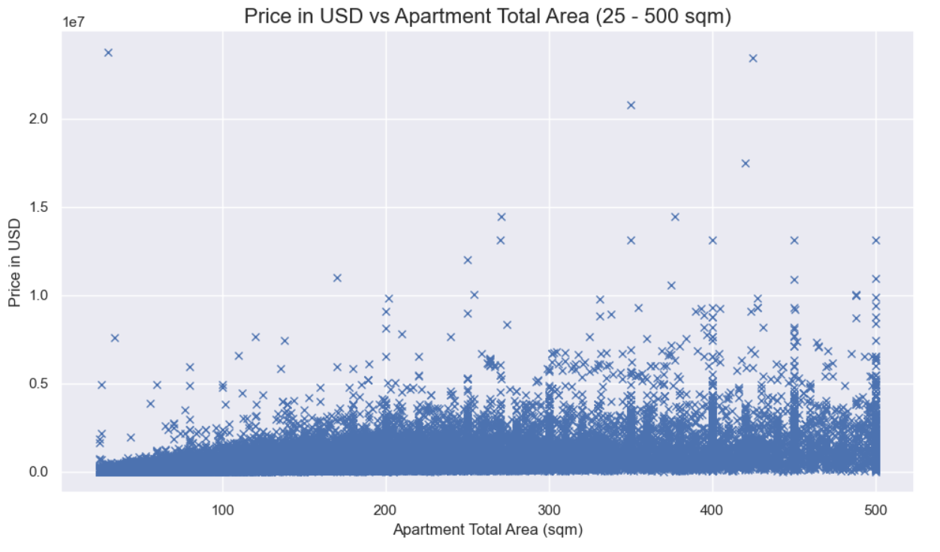

Slide 7
Conclusion
Countries with strong economies, higher demand for real estate, and more developed infrastructure tend to have higher property prices.
1
larger apartments generally had higher prices. This is expected, as larger living spaces typically cost more due to their higher construction costs and appeal to families or buyers looking for more spacious accommodations.
2

Slide 8
THANKS

